Slide 1
Pattern Classification All materials in these slides were taken from Pattern Classification (2nd ed) by R. O. Duda, P. E. Hart and D. G. Stork, John Wiley & Sons, 2000 with the permission of the authors and the publisher

Slide 2
Chapter 4 (Part 1): Non-Parametric Classification (Sections 4.1-4.3)
Introduction
Density Estimation
Parzen Windows

Slide 3
Introduction
All Parametric densities are unimodal (have a single local maximum), whereas many practical problems involve multi-modal densities
Nonparametric procedures can be used with arbitrary distributions and without the assumption that the forms of the underlying densities are known
There are two types of nonparametric methods:
Estimating P(x | ω_{j} )
Bypass probability and go directly to a-posteriori probability estimation

Slide 4
Density Estimation
Basic idea:
Probability that a vector x will fall in region R is:
P is a smoothed (or averaged) version of the density function p(x) if we have a sample of size n; therefore, the probability that k points fall in R is then:
and the expected value for k is:
E(k) = nP (3)

Slide 5
ML estimation of P = θ
is reached for
Therefore, the ratio k/n is a good estimate for the probability P and hence for the density function p.
p(x) is continuous and that the region R is so small that p does not vary significantly within it, we can write:
where is a point within R and V the volume enclosed by R.

Slide 6
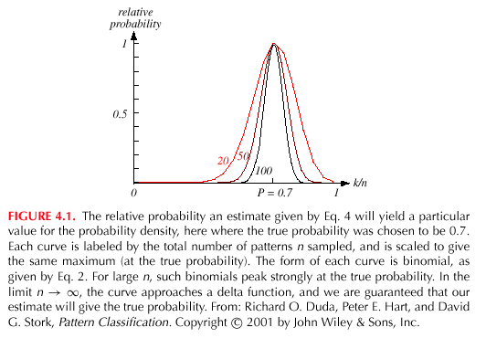
Combining equation (1) , (3) and (4) yields:

Slide 7
Density Estimation (cont.)
Justification of equation (4)
We assume that p(x) is continuous and that region R is so small that p does not vary significantly within R. Since p(x) = constant, it is not a part of the sum.

Slide 8
Where: μ(R) is: a surface in the Euclidean space R²
a volume in the Euclidean space R³
a hypervolume in the Euclidean space R^{n}
Since p(x) ≅ p(x’) = constant, therefore in the Euclidean space R³:

Slide 9
Condition for convergence
The fraction k/(nV) is a space averaged value of p(x).
p(x) is obtained only if V approaches zero.
This is the case where no samples are included in R: it is an uninteresting case!
In this case, the estimate diverges: it is an uninteresting case!

Slide 10
The volume V needs to approach 0 anyway if we want to use this estimation
Practically, V cannot be allowed to become small since the number of samples is always limited
One will have to accept a certain amount of variance in the ratio k/n
Theoretically, if an unlimited number of samples is available, we can circumvent this difficulty
To estimate the density of x, we form a sequence of regions
R₁, R₂,…containing x: the first region contains one sample, the second two samples and so on.
Let V_{n} be the volume of R_{n}, k_{n} the number of samples falling in R_{n} and p_{n}(x) be the n^{th} estimate for p(x):
p_{n}(x) = (k_{n}/n)/V_{n} (7)

Slide 11
Three necessary conditions should apply if we want p_{n}(x) to converge to p(x):
There are two different ways of obtaining sequences of regions that satisfy these conditions:
(a) Shrink an initial region where V_{n} = 1/√n and show that
This is called “the Parzen-window estimation method”
(b) Specify k_{n} as some function of n, such as k_{n} = √n; the volume V_{n} is
grown until it encloses k_{n} neighbors of x. This is called “the k_{n}-nearest
neighbor estimation method”

Slide 12
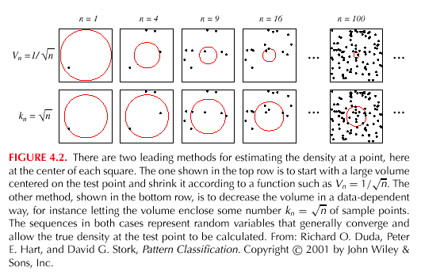

Slide 14
Parzen Windows
Parzen-window approach to estimate densities assume that the region R_{n} is a d-dimensional hypercube
ϕ((x-x_{i})/h_{n}) is equal to unity if x_{i} falls within the hypercube of volume V_{n} centered at x and equal to zero otherwise.

Slide 15
The number of samples in this hypercube is:
By substituting k_{n} in equation (7), we obtain the following estimate:
P_{n}(x) estimates p(x) as an average of functions of x and
the samples (x_{i}) (i = 1,… ,n). These functions ϕ can be general!

Slide 16
Illustration
The behavior of the Parzen-window method
Case where p(x) →N(0,1)
Let ϕ(u) = (1/√(2π) exp(-u²/2) and h_{n} = h₁/√n (n>1)
(h₁: known parameter)
Thus:
is an average of normal densities centered at the
samples x_{i}.

Slide 17
Numerical results:
For n = 1 and h₁=1
For n = 10 and h = 0.1, the contributions of the individual samples are clearly observable !

Slide 18
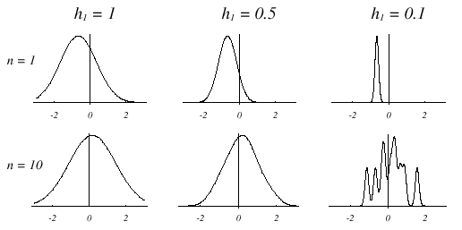

Slide 19
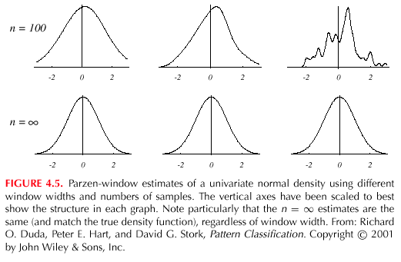

Slide 20
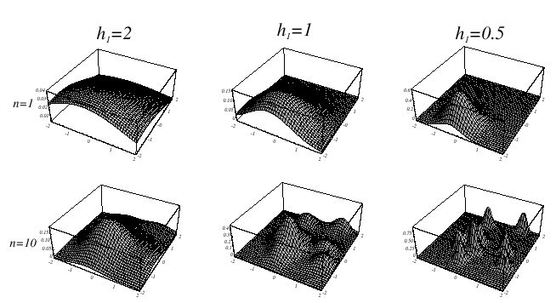
Analogous results are also obtained in two dimensions as illustrated:

Slide 21
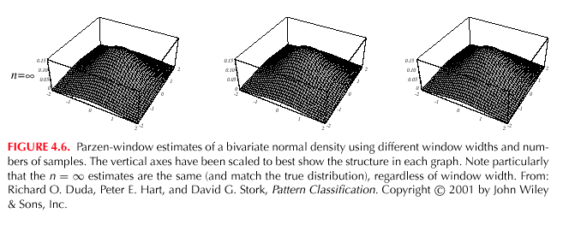

Slide 22
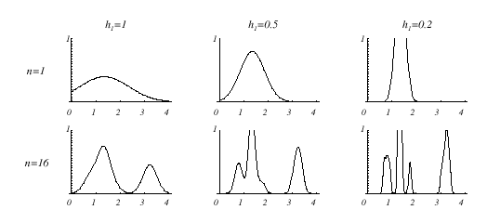
Case where p(x) = λ₁.U(a,b) + λ₂.T(c,d) (unknown density) (mixture of a uniform and a triangle density)

Slide 23
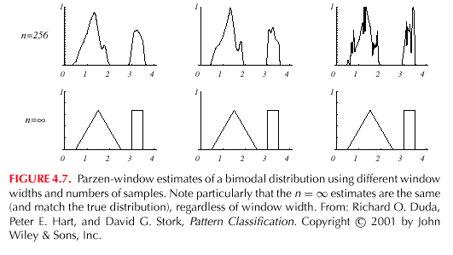

Slide 24
Classification example
In classifiers based on Parzen-window estimation:
We estimate the densities for each category and classify a test point by the label corresponding to the maximum posterior
The decision region for a Parzen-window classifier depends upon the choice of window function as illustrated in the following figure.

Slide 25
